Slide 1
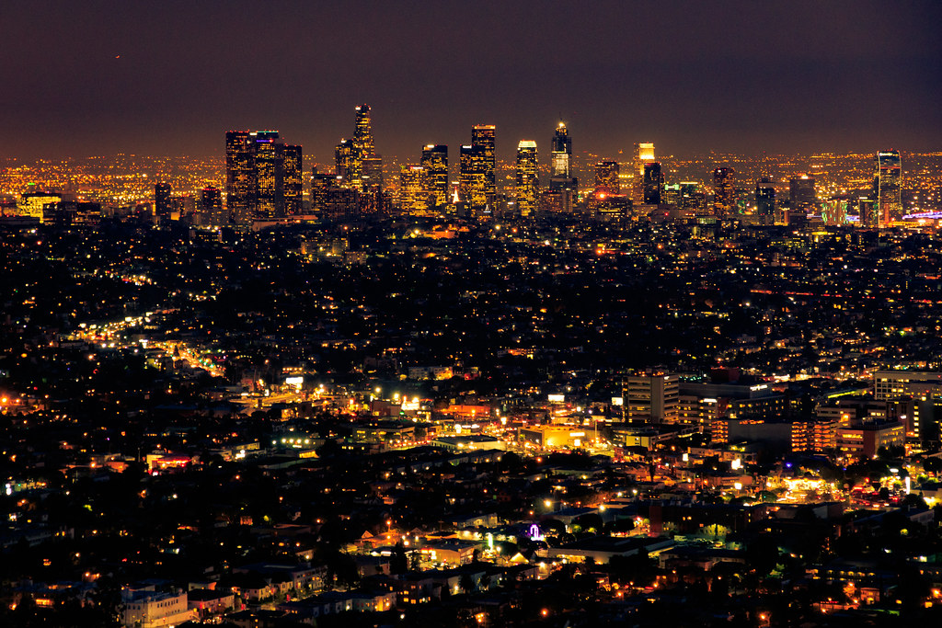
COVID Affects on Los Angeles Crime Rates
Members: Daniel Casey, Jennifer Jones, Lisa Lonstein,
Manjusha Sethi, and Suman Murali
This Photo by Unknown Author is licensed under CC BY

